Slide 1
Optimal Conversion and Put Policies
The first theorem establishes the existence of a boundary of critical host bond prices .
The second theorem describes the boundary in terms of
critical firm value.
The third theorem characterizes the shape and relation of
the boundaries for the different types of bonds.

Slide 2
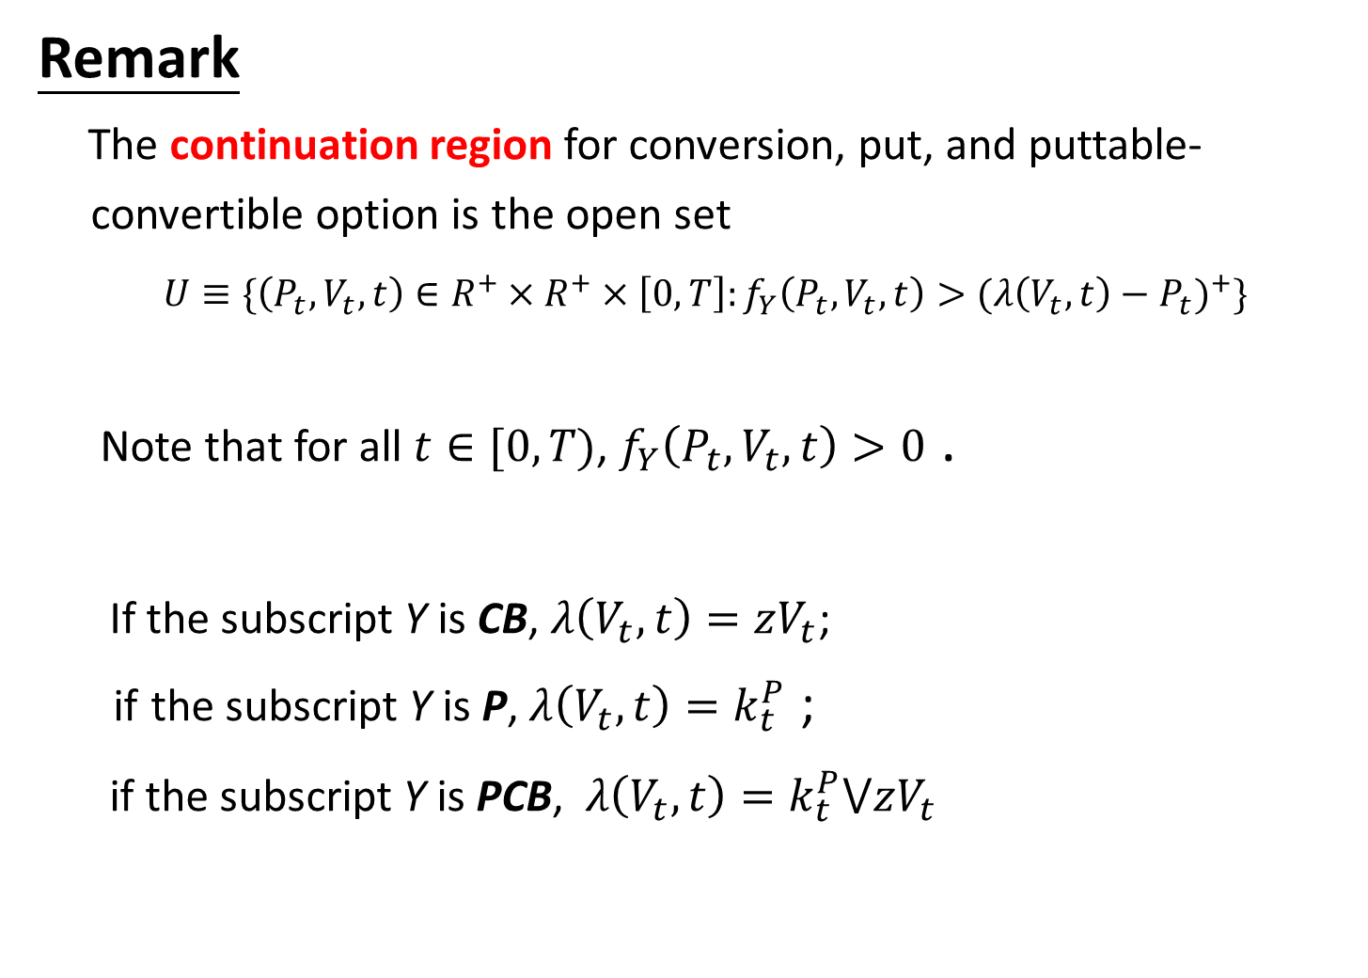
Remark
The continuation region for conversion, put, and puttable-
convertible option is the open set
$U≡\{\left(P_{t},V_{t},t\right)∈R^{+}×R^{+}×\left[0,T\right]:f_{Y}\left(P_{t},V_{t},t\right)>{(λ\left(V_{t},t\right)−P_{t})}^{+}\}$
Note that for all $t∈[0,T)$, $f_{Y}\left(P_{t},V_{t},t\right)>0$ .
If the subscript Y is CB, $λ\left(V_{t},t\right)=zV_{t}$;
if the subscript Y is P, $λ\left(V_{t},t\right)=k_{t}^{P}$ ;
if the subscript Y is PCB, $λ\left(V_{t},t\right)=k_{t}^{P}⋁zV_{t}$
Notes:
Option value is at least equal to time value.

Slide 3
Part 1

Slide 4

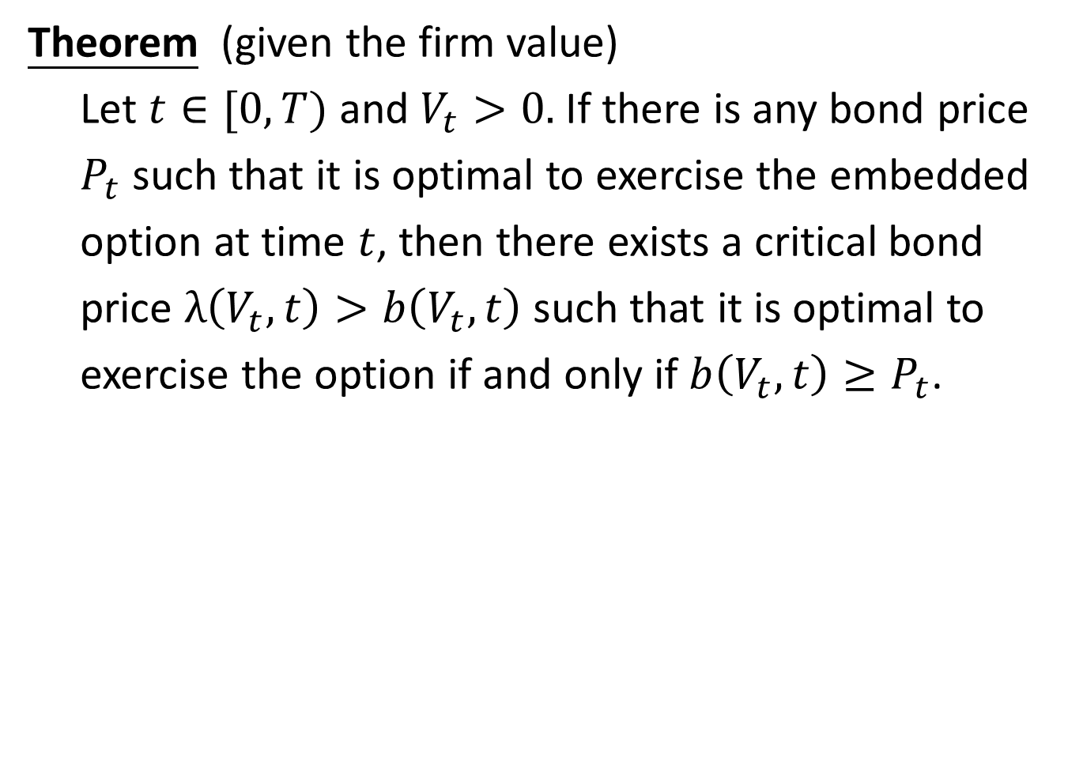
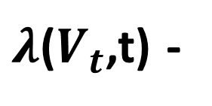
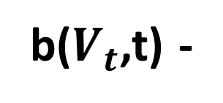

Theorem (given the firm value)
Let $t∈[0,T)$ and $V_{t}>0.$ If there is any bond price
$P_{t}$ such that it is optimal to exercise the embedded
option at time $t$, then there exists a critical bond
price $λ\left(V_{t},t\right)>b\left(V_{t},t\right)$ such that it is optimal to
exercise the option if and only if $b\left(V_{t},t\right)≥P_{t}$.
$$P_{t}$$
Intrinsic Value
$λ$($V_{t}$,t) -
$${\left(λ\left(V_{t} ,t\right)−P_{t}\right)}^{+}$$
b($V_{t}$,t) -
in the money

Slide 5
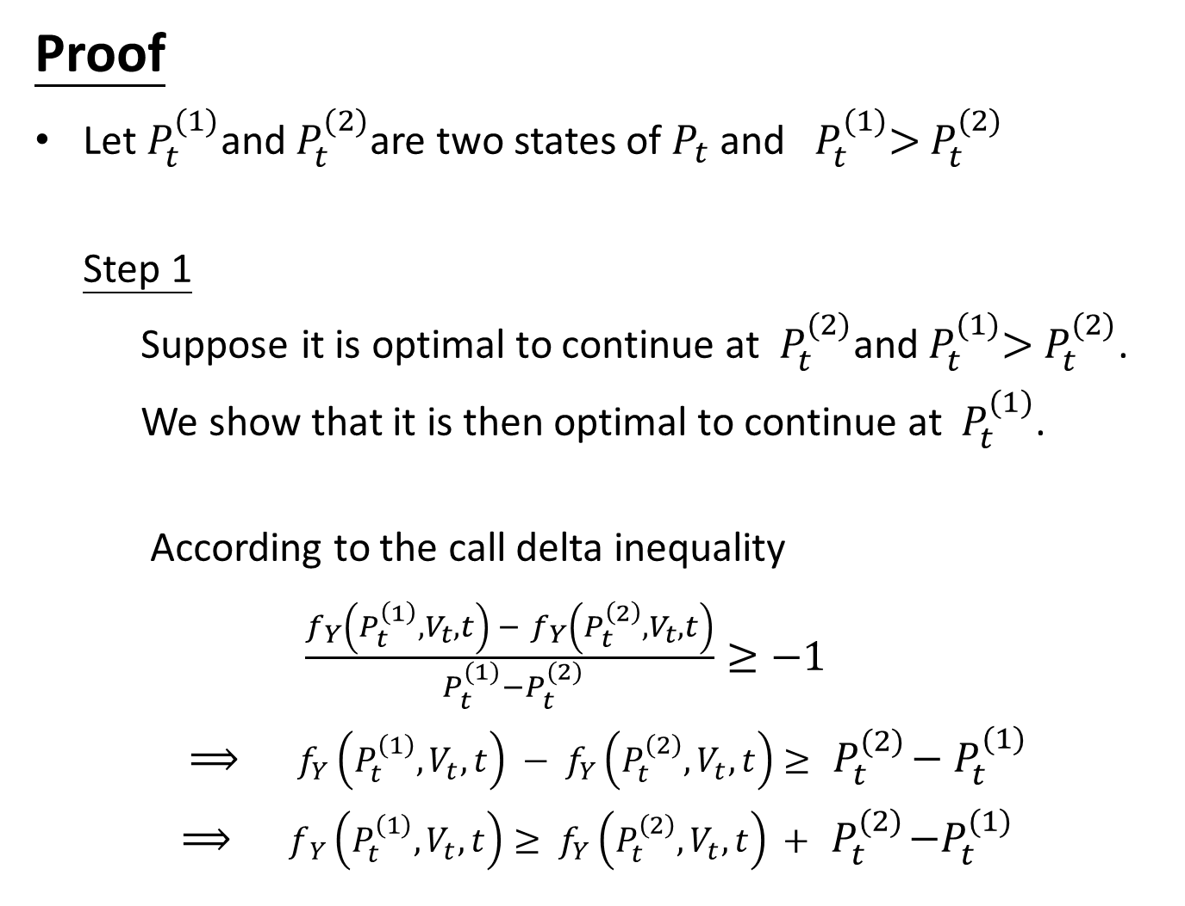
Proof
Let $P_{t}^{(1)}$and $P_{t}^{(2)}$are two states of $P_{t}$ and ${ P}_{t}^{(1)}>$ $P_{t}^{(2)}$
Step 1
Suppose it is optimal to continue at $P_{t}^{(2)}$and${ P}_{t}^{(1)}>$ $P_{t}^{(2)}$.
We show that it is then optimal to continue at $P_{t}^{(1)}$.
According to the call delta inequality
$\frac{f_{Y}\left(P_{t}^{\left(1\right)},V_{t},t\right) − f_{Y}\left(P_{t}^{\left(2\right)},V_{t},t\right)}{{ P}_{t}^{(1)}−P_{t}^{(2)}}≥−1$
$⟹$ $f_{Y}\left(P_{t}^{\left(1\right)},V_{t},t\right) − f_{Y}\left(P_{t}^{\left(2\right)},V_{t},t\right)≥ { P}_{t}^{\left(2\right)}−$ $P_{t}^{(1)}$
$⟹$ $f_{ Y}\left(P_{t}^{\left(1\right)},V_{t},t\right)≥ f_{Y}\left(P_{t}^{\left(2\right)},V_{t},t\right) + { P}_{t}^{\left(2\right)}−P_{t}^{(1)}$

Slide 6
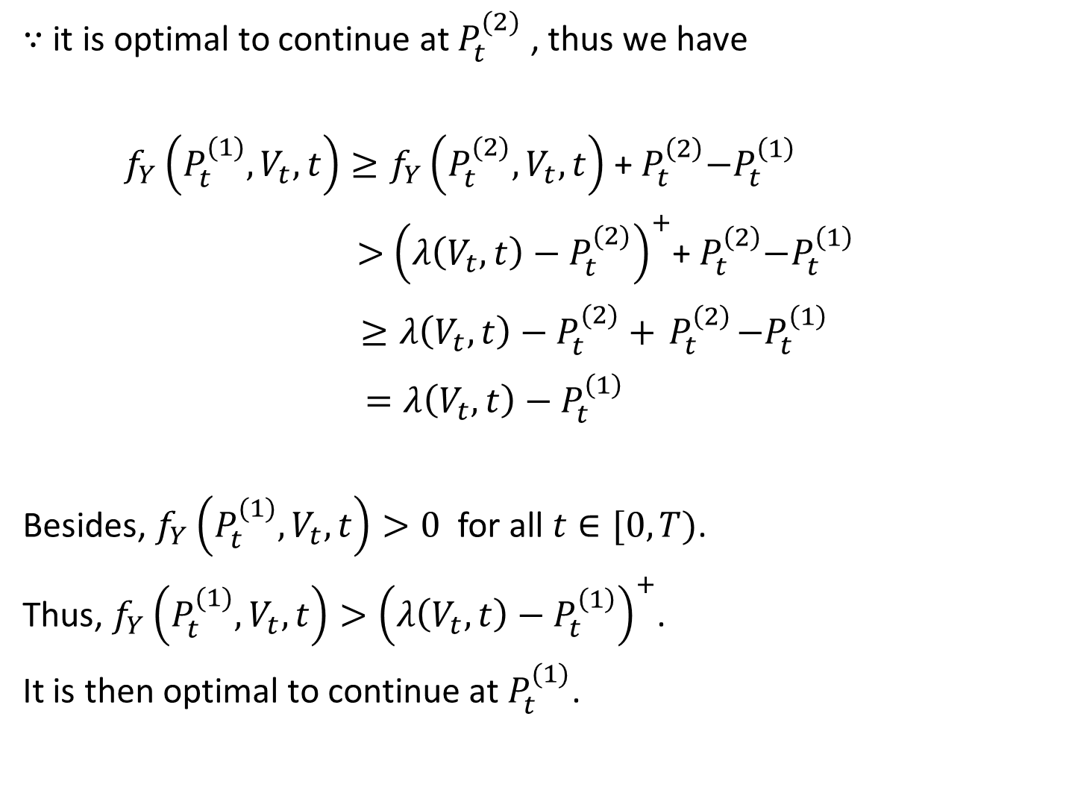
$∵$ it is optimal to continue at $P_{t}^{(2)}$ , thus we have
$f_{Y}\left(P_{t}^{(1)},V_{t},t\right)≥f_{Y}\left(P_{t}^{(2)},V_{t},t\right)$ +${ P}_{t}^{\left(2\right)}−P_{t}^{\left(1\right)}$
$>$ ${\left({λ\left(V_{t},t\right)−P}_{t}^{(2)}\right)}^{+}$+${ P}_{t}^{\left(2\right)}−P_{t}^{\left(1\right)}$
$≥{λ\left(V_{t},t\right)−P}_{t}^{(2)}+{ P}_{t}^{\left(2\right)}−P_{t}^{\left(1\right)}$
$=λ\left(V_{t},t\right)−P_{t}^{\left(1\right)}$
Besides, $f_{Y}\left(P_{t}^{(1)},V_{t},t\right)>0$ for all $t∈[0,T)$.
Thus, $f_{Y}\left(P_{t}^{(1)},V_{t},t\right)>{\left(λ\left(V_{t},t\right)−P_{t}^{\left(1\right)}\right)}^{+}$.
It is then optimal to continue at $P_{t}^{(1)}$.
in U

Slide 7
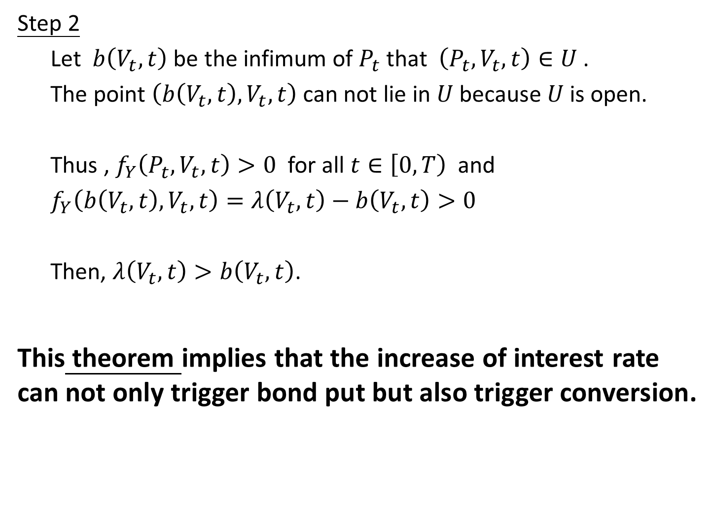
Step 2
Let $b\left(V_{t},t\right)$ be the infimum of $P_{t}$ that $\left(P_{t},V_{t}, t\right)∈U$ .
The point $\left(b\left(V_{t},t\right),V_{t}, t\right)$can not lie in $U$ because $U$ is open.
Thus , $f_{Y}\left(P_{t}^{},V_{t},t\right)>0$ for all $t∈\left[0,T\right)$ and
$f_{Y}\left(b\left(V_{t},t\right),V_{t}, t\right)=λ\left(V_{t},t\right)−b\left(V_{t},t\right)>0$
Then, $λ\left(V_{t},t\right)>b\left(V_{t},t\right)$.
This theorem implies that the increase of interest rate can not only trigger bond put but also trigger conversion.
not in U

Slide 8
Part 2.A

Slide 9

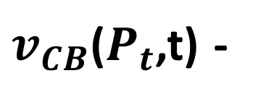



Theorem (given the host bond price)
Let $t∈[0,T)$ and $P_{t}>0$
1. For the pure convertible bond, there exists a critical
firm value $v_{CB}\left(P_{t},t\right)>P_{t}$ such that it is optimal to
default if and only if $V_{t}{≥v}_{CB}\left(P_{t},t\right)$
$$V_{t}$$
Intrinsic Value
in the money
$${\left({zV}_{t}−P_{t}^{}\right)}^{+}$$
$v_{CB}$($P_{t}$,t) -
$P_{t}$ -

Slide 10

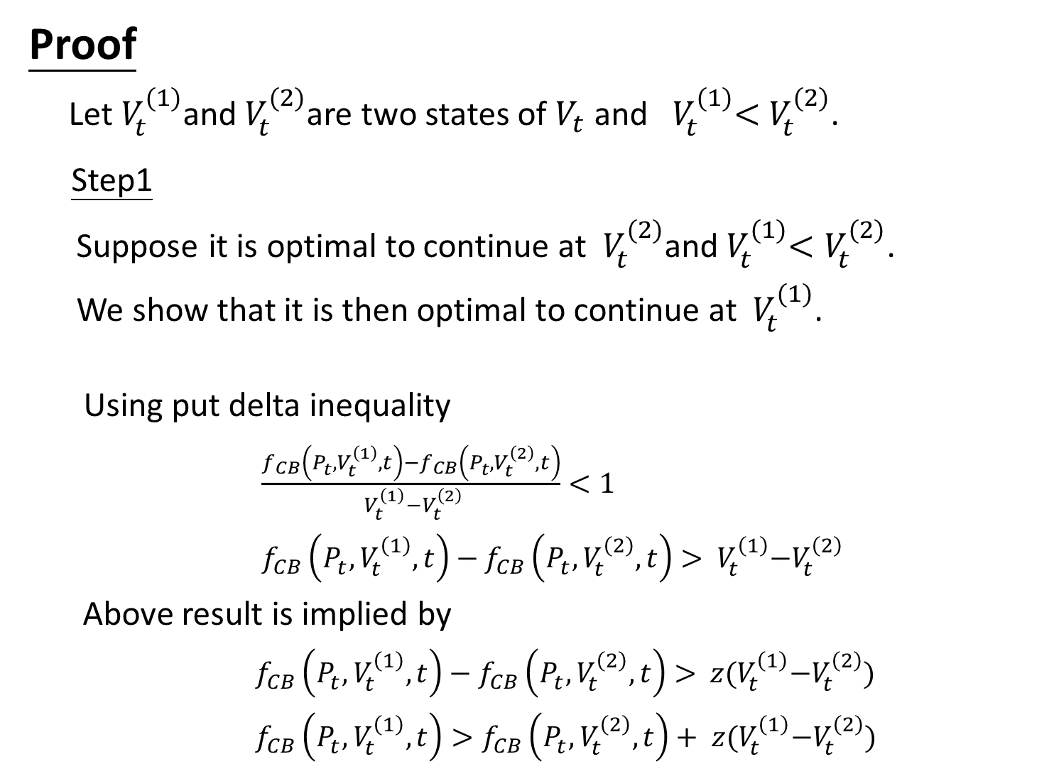

Proof
Let $V_{t}^{(1)}$and $V_{t}^{(2)}$are two states of $V_{t}$ and ${ V}_{t}^{(1)}<$ $V_{t}^{(2)}$.
Step1
Suppose it is optimal to continue at $V_{t}^{(2)}$and${ V}_{t}^{(1)}<V_{t}^{(2)}$.
We show that it is then optimal to continue at $V_{t}^{(1)}$.
Using put delta inequality
$\frac{f_{CB}\left(P_{t}^{},V_{t}^{\left(1\right)},t\right)−f_{CB}\left(P_{t}^{},V_{t}^{\left(2\right)},t\right)}{{ V}_{t}^{\left(1\right)}−V_{t}^{\left(2\right)}}<1$
$f_{CB}\left(P_{t}^{},V_{t}^{\left(1\right)},t\right)−f_{CB}\left(P_{t}^{},V_{t}^{\left(2\right)},t\right)>$ ${ V}_{t}^{\left(1\right)}−V_{t}^{\left(2\right)}$
Above result is implied by
$f_{CB}\left(P_{t}^{},V_{t}^{\left(1\right)},t\right)−f_{CB}\left(P_{t}^{},V_{t}^{\left(2\right)},t\right)>$ ${ z(V}_{t}^{\left(1\right)}−V_{t}^{\left(2\right)})$
$f_{CB}\left(P_{t}^{},V_{t}^{\left(1\right)},t\right)>f_{CB}\left(P_{t}^{},V_{t}^{\left(2\right)},t\right)+$ ${ z(V}_{t}^{\left(1\right)}−V_{t}^{\left(2\right)})$
$⟹$
Review
$⟹$

Slide 11
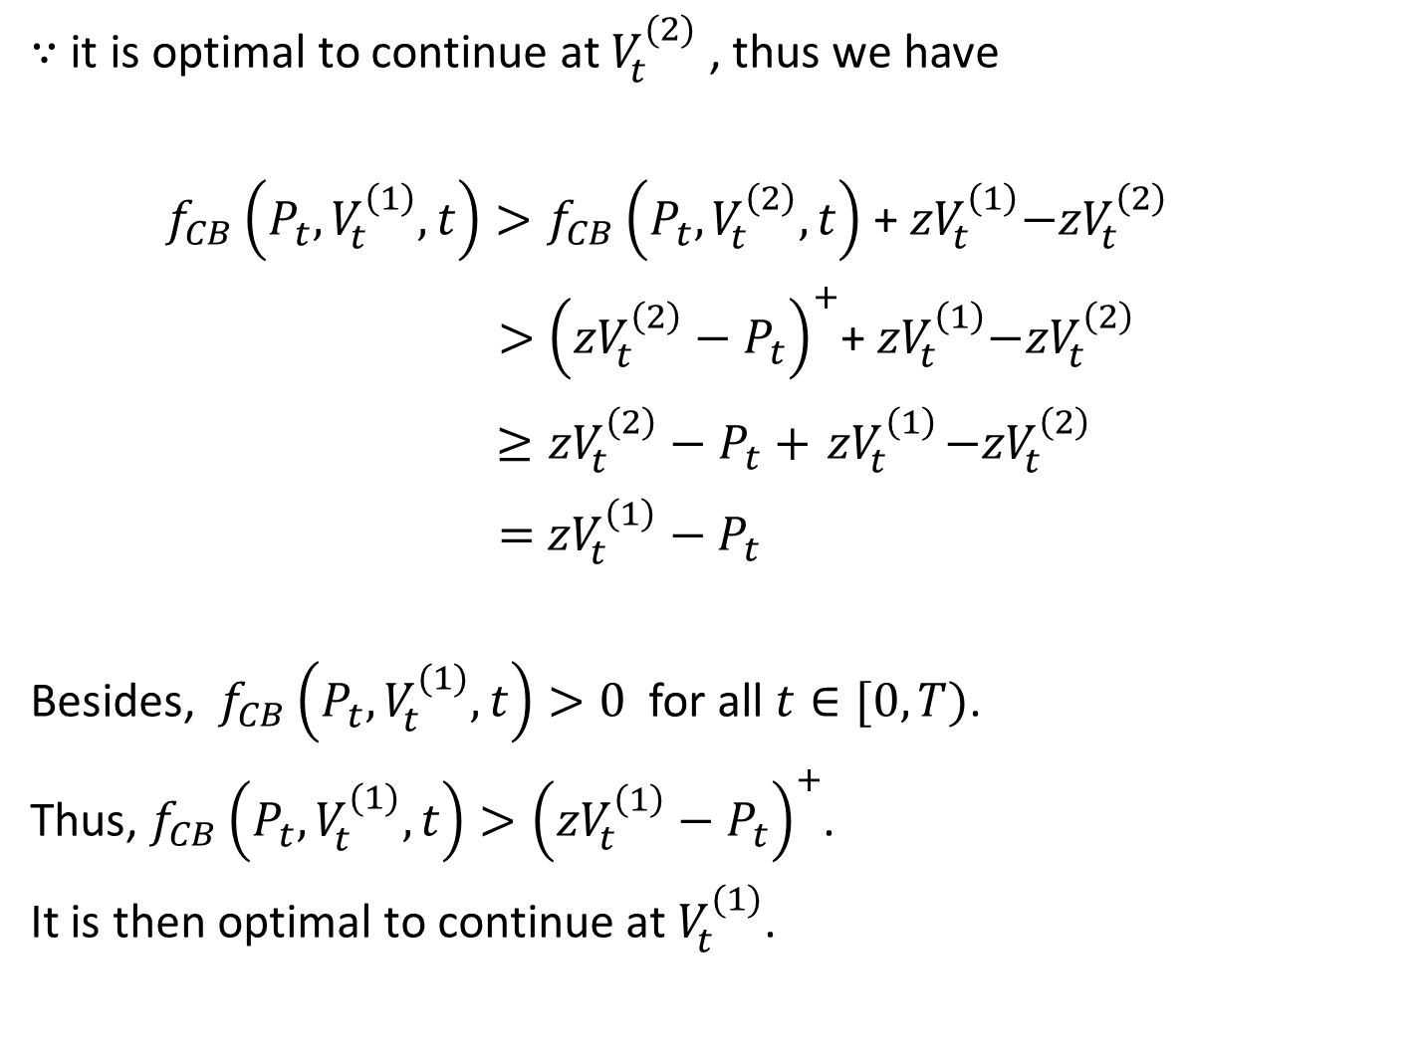
$∵$ it is optimal to continue at $V_{t}^{(2)}$ , thus we have
$f_{CB}\left(P_{t}^{},V_{t}^{\left(1\right)},t\right)>f_{CB}\left(P_{t}^{},V_{t}^{\left(2\right)},t\right)$ +${ zV}_{t}^{\left(1\right)}−{zV}_{t}^{\left(2\right)}$
$>$ ${\left({zV}_{t}^{\left(2\right)}−P_{t}^{}\right)}^{+}$+${ zV}_{t}^{\left(1\right)}−{zV}_{t}^{\left(2\right)}$
$≥{zV}_{t}^{\left(2\right)}−P_{t}^{}+{ zV}_{t}^{\left(1\right)}−{zV}_{t}^{\left(2\right)}$
$=$ ${zV}_{t}^{\left(1\right)}−$ $P_{t}^{}$
Besides, $f_{CB}\left(P_{t}^{},V_{t}^{(1)},t\right)>0$ for all $t∈[0,T)$.
Thus, $f_{CB}\left(P_{t}^{},V_{t}^{(1)},t\right)>{\left({zV}_{t}^{\left(1\right)}−P_{t}^{}\right)}^{+}$.
It is then optimal to continue at $V_{t}^{(1)}$.
in U

Slide 12
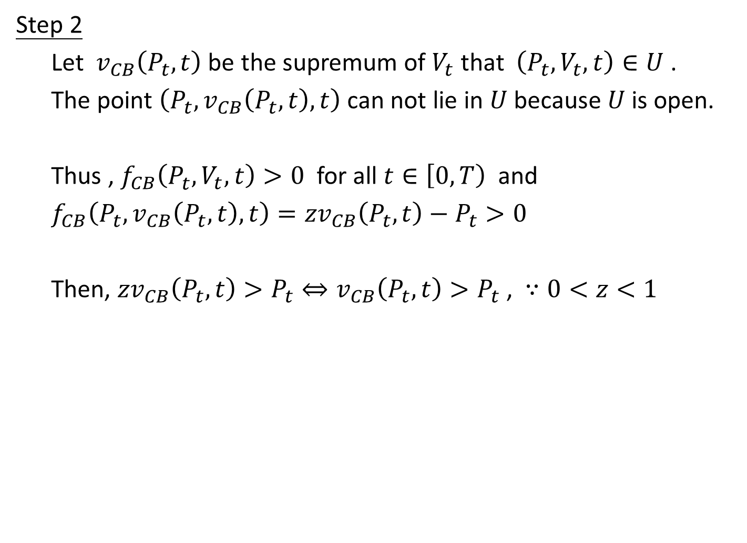
Step 2
Let $v_{CB}\left(P_{t},t\right)$ be the supremum of $V_{t}$ that $\left(P_{t},V_{t}, t\right)∈U$ .
The point $\left(P_{t},v_{CB}\left(P_{t},t\right), t\right)$can not lie in $U$ because $U$ is open.
Thus , $f_{CB}\left(P_{t}^{},V_{t},t\right)>0$ for all $t∈\left[0,T\right)$ and
$f_{CB}\left(P_{t},v_{CB}\left(P_{t},t\right), t\right)={zv}_{CB}\left(P_{t},t\right)−P_{t}>0$
Then, ${zv}_{CB}\left(P_{t},t\right)>P_{t}⇔v_{CB}\left(P_{t},t\right)>P_{t}$ , $∵0<z<1$
not in U

Slide 13
Part 2.B

Slide 14
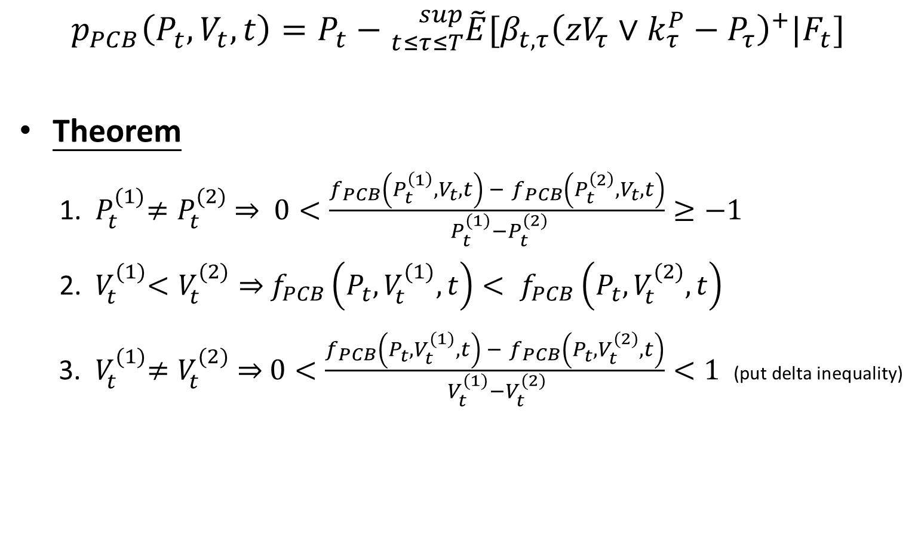
Bond Valuation
$$p_{PCB}\left(P_{t}^{},V_{t},t\right)=P_{t}−{}_{t≤τ≤T}^{sup}{\tilde{E}[β_{t,τ}{\left({zV}_{τ}∨k_{τ}^{P}−P_{τ}^{}\right)}^{+}|F_{t}]}$$
Theorem
1. ${ P}_{t}^{(1)}≠P_{t}^{(2)}$ $⇒$ $0<\frac{f_{PCB}\left(P_{t}^{\left(1\right)},V_{t},t\right) − f_{PCB}\left(P_{t}^{\left(2\right)},V_{t},t\right)}{{ P}_{t}^{(1)}−P_{t}^{(2)}}≥−1$
2. ${ V}_{t}^{(1)}<V_{t}^{(2)}⇒$ $f_{PCB}\left(P_{t}^{},V_{t}^{(1)},t\right)< f_{PCB}\left(P_{t}^{},V_{t}^{(2)},t\right)$
3.${ V}_{t}^{(1)}≠V_{t}^{(2)}$ $⇒$ $0<\frac{f_{PCB}\left(P_{t}^{},V_{t}^{(1)},t\right) − f_{PCB}\left(P_{t}^{},V_{t}^{(2)},t\right)}{{ V}_{t}^{(1)}−V_{t}^{(2)}}<1$ (put delta inequality)
Back_p20

Slide 15
Part 2.B-1

Slide 16


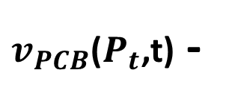

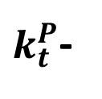


2-1 For the (default-free) puttable-convertible bond,
$V_{t}≥k_{t}^{P},$
there exists a critical firm value $v_{PCB}\left(P_{t},t\right)$, satisfying
$v_{PCB}\left(P_{t},t\right)>k_{t}^{P}$ (implied by z$v_{PCB}\left(P_{t},t\right)≥k_{t}^{P}$)
, and $v_{PCB}\left(P_{t},t\right)>P_{t}$ such that it is optimal to convert
if and only if $V_{t}{≥v}_{PCB}\left(P_{t},t\right)$.
Intrinsic Value
$$V_{t}$$
$v_{PCB}$($P_{t}$,t) -
$${\left({zV}_{t}∨k_{t}^{P}−P_{t}^{}\right)}^{+}$$
${zv}_{PCB}$($P_{t}$,t)
$k_{t}^{P}$-
$P_{t}$ -

Slide 17
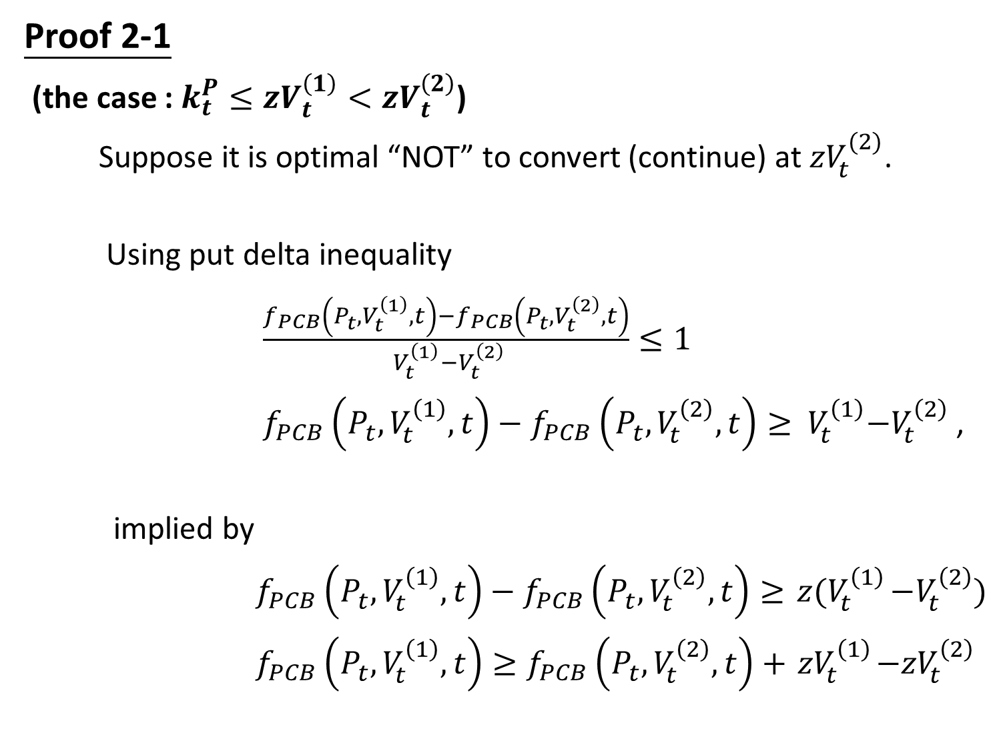
Proof 2-1
(the case : $k_{t}^{P}≤{zV}_{t}^{\left(1\right)}<{zV}_{t}^{\left(2\right)}$)
Suppose it is optimal “NOT” to convert (continue) at ${zV}_{t}^{(2)}$.
Using put delta inequality
$\frac{f_{PCB}\left(P_{t}^{},V_{t}^{\left(1\right)},t\right)−f_{PCB}\left(P_{t}^{},V_{t}^{\left(2\right)},t\right)}{{ V}_{t}^{\left(1\right)}−V_{t}^{\left(2\right)}}≤1$
$f_{PCB}\left(P_{t}^{},V_{t}^{\left(1\right)},t\right)−f_{PCB}\left(P_{t}^{},V_{t}^{\left(2\right)},t\right)≥$ ${ V}_{t}^{\left(1\right)}−V_{t}^{\left(2\right)}$ ,
implied by
$f_{PCB}\left(P_{t}^{},V_{t}^{\left(1\right)},t\right)−f_{PCB}\left(P_{t}^{},V_{t}^{\left(2\right)},t\right)≥{ z(V}_{t}^{\left(1\right)}−V_{t}^{\left(2\right)})$
$f_{PCB}\left(P_{t}^{},V_{t}^{\left(1\right)},t\right)≥f_{PCB}\left(P_{t}^{},V_{t}^{\left(2\right)},t\right)+{ zV}_{t}^{\left(1\right)}−{zV}_{t}^{\left(2\right)}$

Slide 18

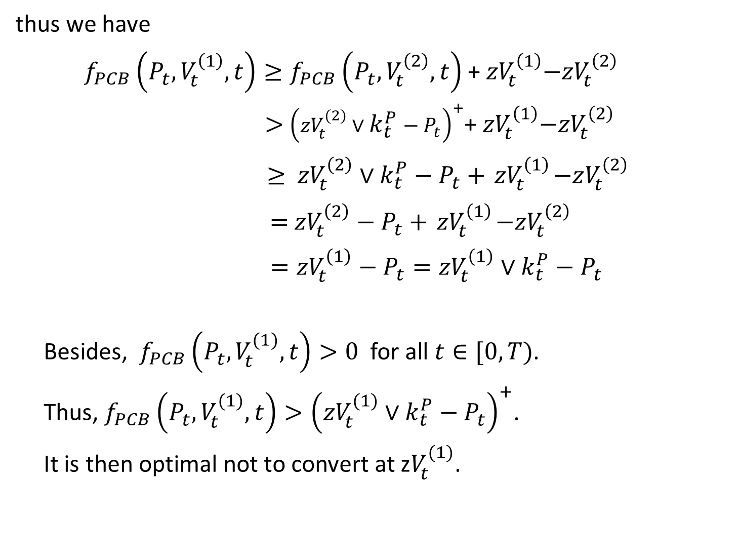
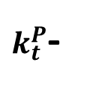

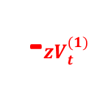
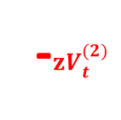

thus we have
$f_{PCB}\left(P_{t}^{},V_{t}^{\left(1\right)},t\right)≥f_{PCB}\left(P_{t}^{},V_{t}^{\left(2\right)},t\right)$ +${ zV}_{t}^{\left(1\right)}−{zV}_{t}^{\left(2\right)}$
$>$ ${\left({zV}_{t}^{(2)}∨k_{t}^{P}−P_{t}^{}\right)}^{+}$+${ zV}_{t}^{\left(1\right)}−{zV}_{t}^{\left(2\right)}$
$≥$ ${zV}_{t}^{\left(2\right)}∨k_{t}^{P}−P_{t}^{}+{ zV}_{t}^{\left(1\right)}−zV_{t}^{\left(2\right)}$
$=$ ${zV}_{t}^{\left(2\right)}−P_{t}^{}+{ zV}_{t}^{\left(1\right)}−{zV}_{t}^{\left(2\right)}$
$={zV}_{t}^{\left(1\right)}−P_{t}^{}={zV}_{t}^{\left(1\right)}∨k_{t}^{P}−P_{t}^{}$
Besides, $f_{PCB}\left(P_{t}^{},V_{t}^{(1)},t\right)>0$ for all $t∈[0,T)$.
Thus, $f_{PCB}\left(P_{t}^{},V_{t}^{(1)},t\right)>{\left({zV}_{t}^{(1)}∨k_{t}^{P}−P_{t}^{}\right)}^{+}$.
It is then optimal not to convert at z$V_{t}^{(1)}$.
in U
$$V_{t}$$
${zv}_{PCB}$($P_{t}$,t)
-$zV_{t}^{(2)}$
-${zV}_{t}^{(1)}$
$k_{t}^{P}$-
$P_{t}$ -

Slide 19
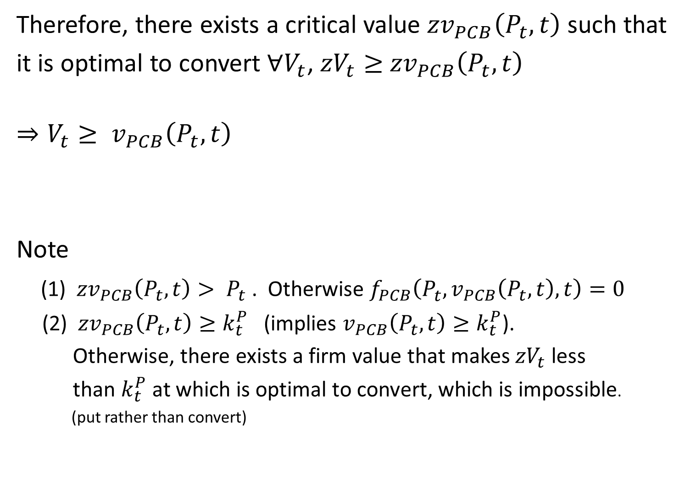
Therefore, there exists a critical value ${zv}_{PCB}\left(P_{t},t\right)$ such that
it is optimal to convert $∀V_{t}$, ${zV}_{t}≥$ ${zv}_{PCB}\left(P_{t},t\right)$
$$⇒V_{t}≥ v_{PCB}\left(P_{t},t\right)$$
Note
(1) ${zv}_{PCB}\left(P_{t},t\right)> P_{t}$ . Otherwise $f_{PCB}\left(P_{t}^{},v_{PCB}\left(P_{t},t\right),t\right)=0$
(2) ${zv}_{PCB}\left(P_{t},t\right)≥k_{t}^{P}$ (implies $v_{PCB}\left(P_{t},t\right)≥k_{t}^{P}$).
Otherwise, there exists a firm value that makes ${zV}_{t}$less
than $k_{t}^{P}$ at which is optimal to convert, which is impossible.
(put rather than convert)

Slide 20
Part 2.B-2

Slide 21




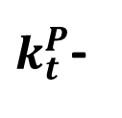




2-2 If there exists any firm value $V_{t}$, $V_{t}≥k_{t}^{P},$ at which it is
optimal to put at time t, then there exists a critical firm value
${\overline{v}}_{PCB}\left(P_{t},t\right)$ and $z{\overline{v}}_{PCB}\left(P_{t},t\right)≤k_{t}^{P}$such that it is optimal
to put if and only if $k_{t}^{P}{≤V}_{t}{≤\overline{v}}_{PCB}\left(P_{t},t\right)$
the case of optimal to convert
the case of optimal to put
$$V_{t}$$
Intrinsic Value
$v_{PCB}$($P_{t}$,t) -
$${\left({zV}_{t}∨k_{t}^{P}−P_{t}^{}\right)}^{+}$$
${\overline{v}}_{PCB}\left(P_{t},t\right)$ -
$k_{t}^{P}$-
${zv}_{PCB}$($P_{t}$,t)
${z\overline{v}}_{PCB}$($P_{t}$,t)
$P_{t}$ -

Slide 22
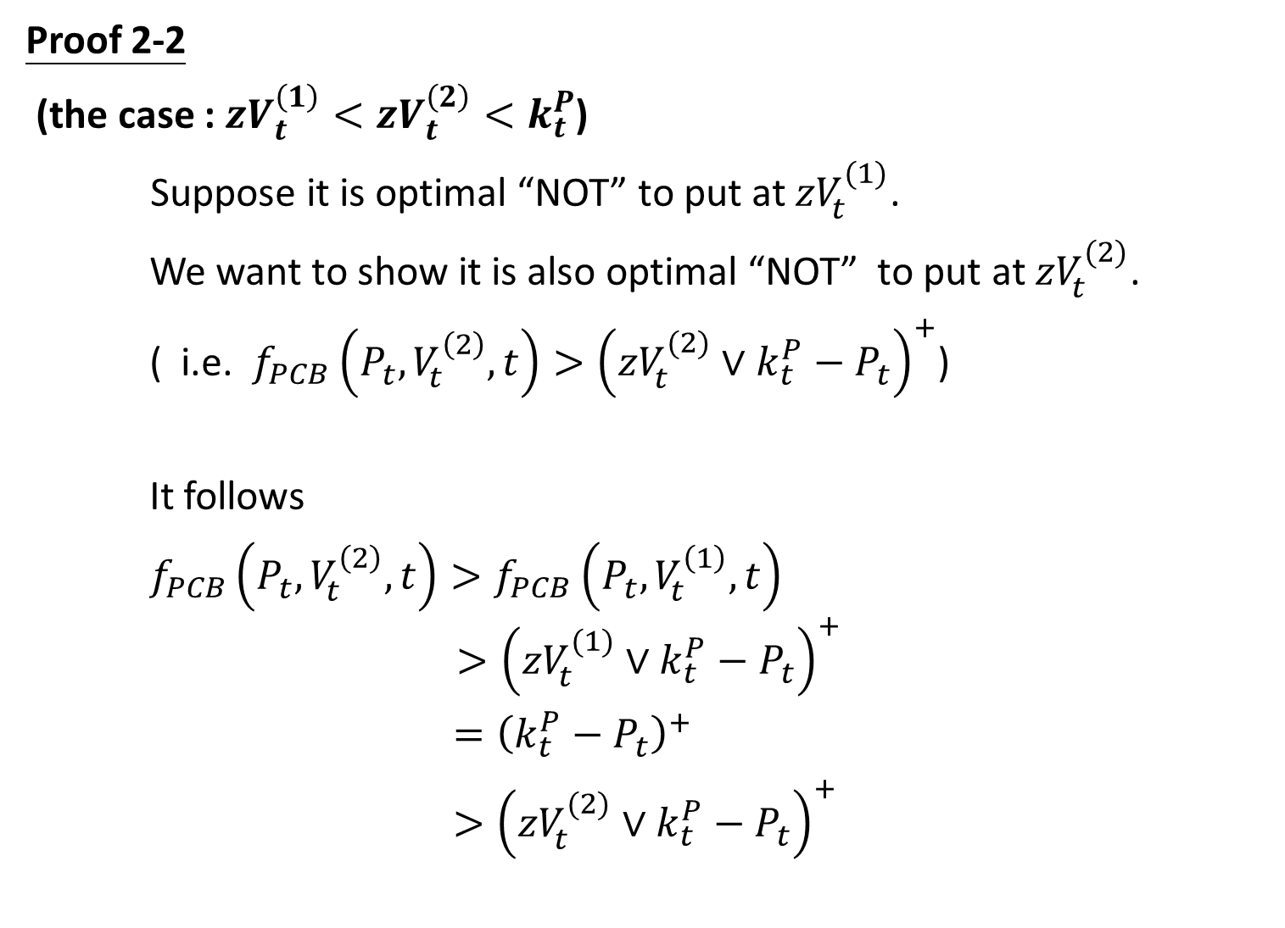
Proof 2-2
(the case : ${zV}_{t}^{\left(1\right)}<{zV}_{t}^{\left(2\right)}<k_{t}^{P}$)
Suppose it is optimal “NOT” to put at ${zV}_{t}^{(1)}$.
We want to show it is also optimal “NOT” to put at ${zV}_{t}^{(2)}$.
( i.e. $f_{PCB}\left(P_{t}^{},V_{t}^{\left(2\right)},t\right)>{\left({zV}_{t}^{(2)}∨k_{t}^{P}−P_{t}^{}\right)}^{+}$)
It follows
$f_{PCB}\left(P_{t}^{},V_{t}^{\left(2\right)},t\right)>f_{PCB}\left(P_{t}^{},V_{t}^{\left(1\right)},t\right)$
$$>{\left({zV}_{t}^{(1)}∨k_{t}^{P}−P_{t}^{}\right)}^{+}$$
$={\left(k_{t}^{P}−P_{t}^{}\right)}^{+}$
$>{\left({zV}_{t}^{(2)}∨k_{t}^{P}−P_{t}^{}\right)}^{+}$
By Thm of PCB, part 2
Review
in U

Slide 23
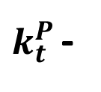

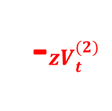
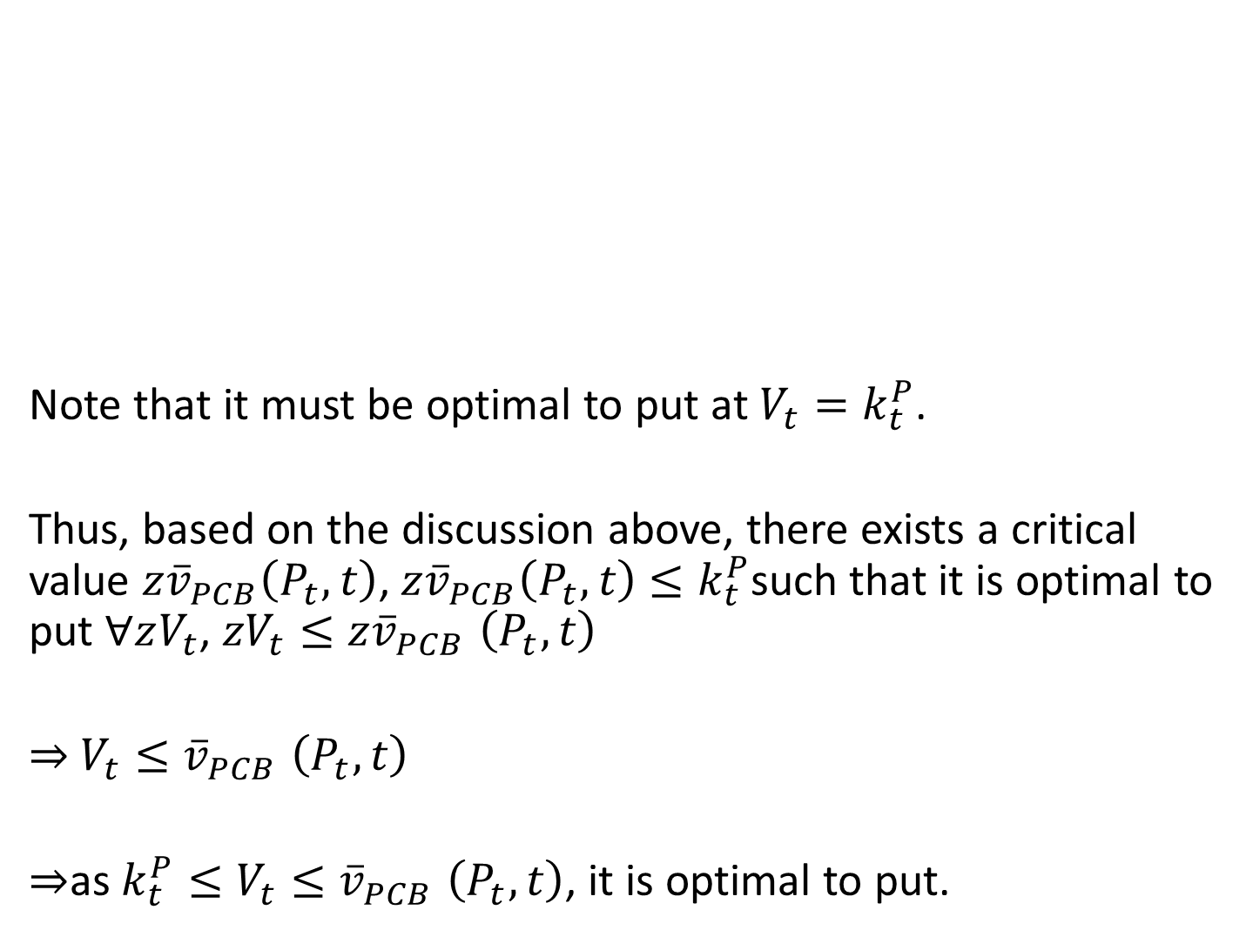
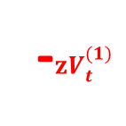
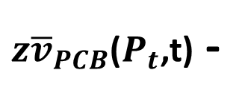

Note that it must be optimal to put at $V_{t}=k_{t}^{P}$.
Thus, based on the discussion above, there exists a critical value ${z\overline{v}}_{PCB}\left(P_{t},t\right)$, ${z\overline{v}}_{PCB}\left(P_{t},t\right)$ $≤k_{t}^{P}$such that it is optimal to put $∀zV_{t}$, ${zV}_{t}{≤z\overline{v}}_{PCB}\left(P_{t},t\right)$
$⇒$ $V_{t}{≤\overline{v}}_{PCB}\left(P_{t},t\right)$
$⇒$as ${k_{t}^{P}≤V}_{t}{≤\overline{v}}_{PCB}\left(P_{t},t\right)$, it is optimal to put.
$$V_{t}$$
$k_{t}^{P }$-
-${zV}_{t}^{(2)}$
-$zV_{t}^{(1)}$
${z\overline{v}}_{PCB}$($P_{t}$,t) -
$P_{t}$ -

Slide 24
Part 3.A

Slide 25

Theorem 3.A For each $t∈[0,T)$ ,
1. $V_{t}^{(1)}<V_{t}^{(2)}⟹b_{CB}(V_{t}^{\left(1\right)},t)≤b_{CB}(V_{t}^{\left(2\right)},t)$
2. $P_{t}^{(1)}>P_{t}^{(2)}⟹v_{CB}(P_{t}^{\left(1\right)},t)≥v_{CB}(P_{t}^{\left(2\right)},t)$

Slide 26
Theorem 3.A For each $t∈[0,T)$ ,
1. $V_{t}^{(1)}<V_{t}^{(2)}⟹b_{CB}(V_{t}^{\left(1\right)},t)≤b_{CB}(V_{t}^{\left(2\right)},t)$
2. $P_{t}^{(1)}>P_{t}^{(2)}⟹v_{CB}(P_{t}^{\left(1\right)},t)≥v_{CB}(P_{t}^{\left(2\right)},t)$

Slide 27

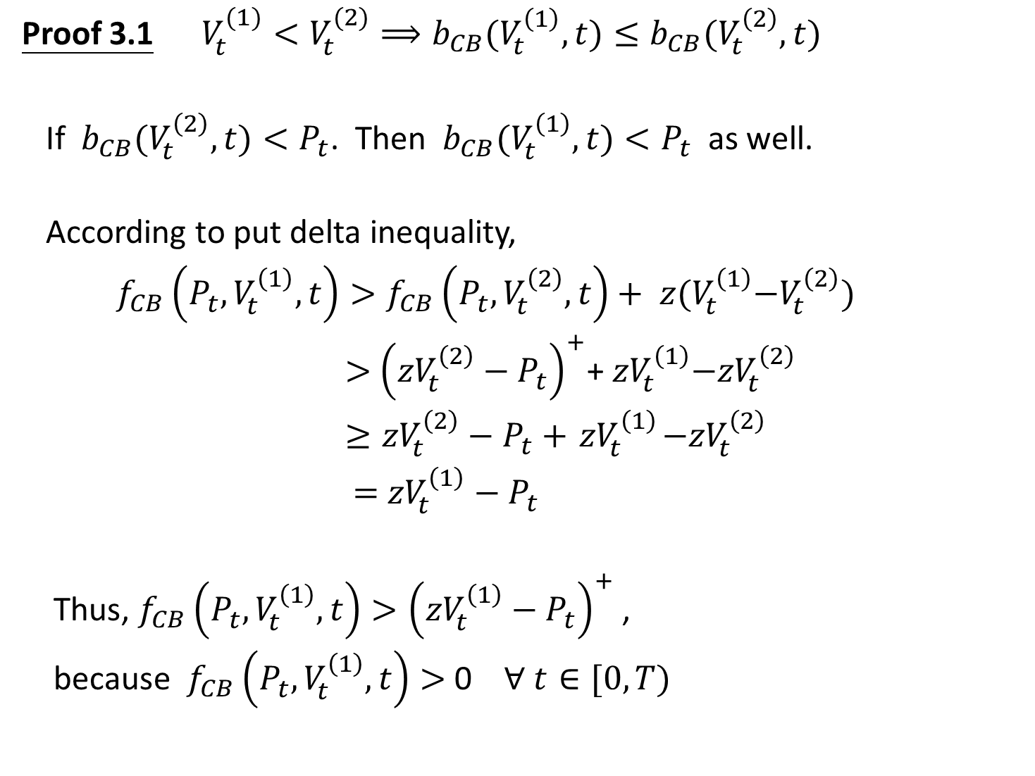
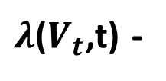
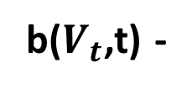
$$P_{t}$$
Proof 3.1 $V_{t}^{(1)}<V_{t}^{(2)}⟹b_{CB}(V_{t}^{\left(1\right)},t)≤b_{CB}(V_{t}^{\left(2\right)},t)$
If $b_{CB}(V_{t}^{\left(2\right)},t){<P}_{t}$. Then $b_{CB}(V_{t}^{\left(1\right)},t){<P}_{t}$ as well.
According to put delta inequality,
$f_{CB}\left(P_{t}^{},V_{t}^{\left(1\right)},t\right)>f_{CB}\left(P_{t}^{},V_{t}^{\left(2\right)},t\right)+$ ${ z(V}_{t}^{\left(1\right)}−V_{t}^{\left(2\right)})$
$>$ ${\left({zV}_{t}^{\left(2\right)}−P_{t}^{}\right)}^{+}$+${ zV}_{t}^{\left(1\right)}−{zV}_{t}^{\left(2\right)}$
$≥{zV}_{t}^{\left(2\right)}−P_{t}^{}+{ zV}_{t}^{\left(1\right)}−{zV}_{t}^{\left(2\right)}$
$=$ ${zV}_{t}^{\left(1\right)}−$ $P_{t}^{}$
Thus, $f_{CB}\left(P_{t}^{},V_{t}^{\left(1\right)},t\right)>{\left({zV}_{t}^{\left(1\right)}−P_{t}^{}\right)}^{+}$ ,
because $f_{CB}\left(P_{t}^{},V_{t}^{\left(1\right)},t\right)>$ 0 $\text{∀} t∈[0,T)$
$λ$($V_{t}$,t) -
in U
b($V_{t}$,t) -
in U

Slide 28
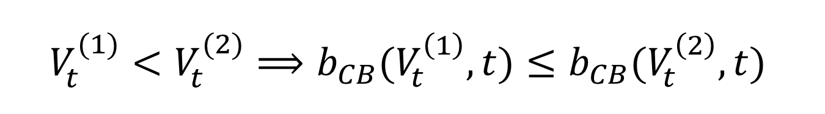
$$V_{t}^{(1)}<V_{t}^{(2)}⟹b_{CB}(V_{t}^{\left(1\right)},t)≤b_{CB}(V_{t}^{\left(2\right)},t)$$
The higher the firm value, the higher the bond
value must be to trigger conversion.
(the easier to trigger conversion)

Slide 29

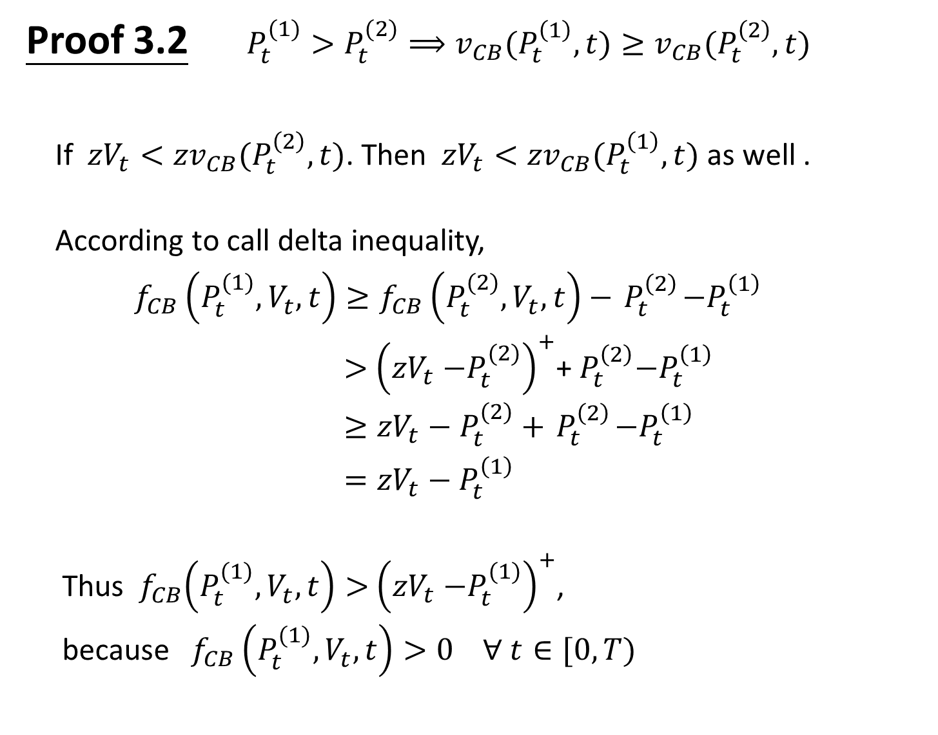


Proof 3.2 $P_{t}^{(1)}>P_{t}^{(2)}⟹v_{CB}(P_{t}^{\left(1\right)},t)≥v_{CB}(P_{t}^{\left(2\right)},t)$
If ${zV}_{t}<{zv}_{CB}(P_{t}^{\left(2\right)},t)$. Then ${zV}_{t}<{zv}_{CB}(P_{t}^{\left(1\right)},t)$ as well .
According to call delta inequality,
$f_{CB}\left(P_{t}^{(1)},V_{t}^{},t\right)≥f_{CB}\left(P_{t}^{(2)},V_{t}^{},t\right)−{ P}_{t}^{\left(2\right)}−P_{t}^{\left(1\right)}$
$>$ ${\left({zV}_{t}{−P}_{t}^{(2)}\right)}^{+}$+${ P}_{t}^{\left(2\right)}−P_{t}^{\left(1\right)}$
$≥{{zV}_{t}−P}_{t}^{(2)}+{ P}_{t}^{\left(2\right)}−P_{t}^{\left(1\right)}$
$={zV}_{t}−P_{t}^{\left(1\right)}$
Thus ${ f}_{CB}\left(P_{t}^{(1)},V_{t}^{},t\right)>$ ${\left({zV}_{t}{−P}_{t}^{(1)}\right)}^{+}$,
because $f_{CB}\left(P_{t}^{(1)},V_{t}^{},t\right)>0$ $\text{∀} t∈[0,T)$
in U
in U
$$V_{t}$$
in U
${zv}_{CB}$($V_{t}$,t) -
$P_{t}$ -

Slide 30
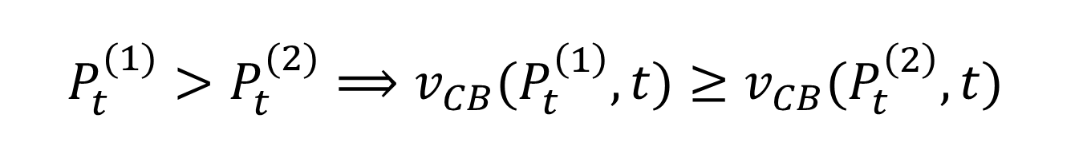

$$P_{t}^{(1)}>P_{t}^{(2)}⟹v_{CB}(P_{t}^{\left(1\right)},t)≥v_{CB}(P_{t}^{\left(2\right)},t)$$
The discussion above suggests
${zv}_{CB}(P_{t}^{\left(1\right)},t)≥$ ${zv}_{CB}(P_{t}^{\left(2\right)},t)$
$⇒$ $v_{CB}(P_{t}^{\left(1\right)},t)≥$ $v_{CB}(P_{t}^{\left(2\right)},t)$
In high interest rate environments, it takes lower
firm values to make bond holders convert their
bond.

Slide 31
Part 3.B

Slide 32
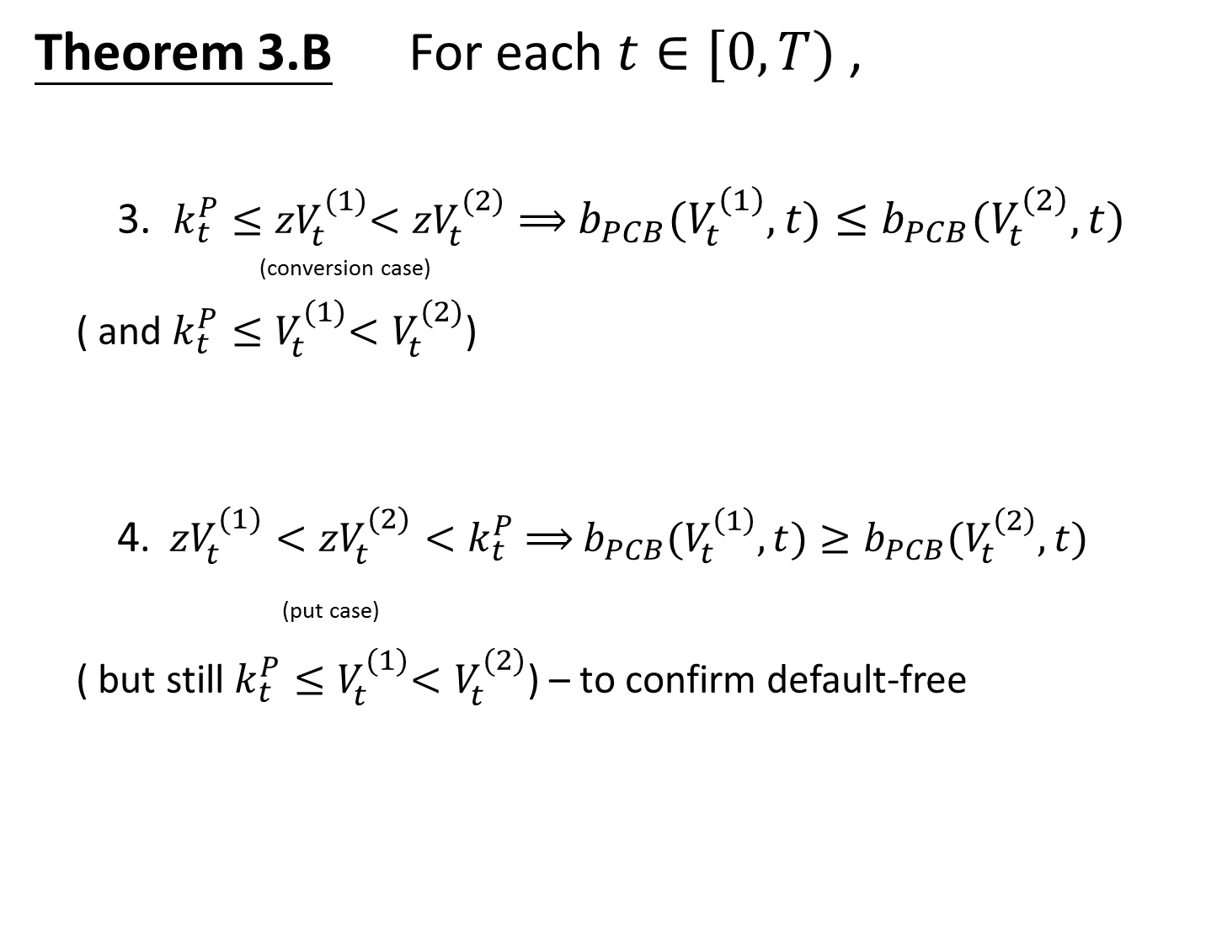
Theorem 3.B For each $t∈[0,T)$ ,
3. $k_{t}^{P}{≤zV}_{t}^{(1)}<{zV}_{t}^{(2)}⟹$ $b_{PCB}(V_{t}^{\left(1\right)},t)≤b_{PCB}(V_{t}^{\left(2\right)},t)$
(conversion case)
( and $k_{t}^{P}{≤V}_{t}^{(1)}<V_{t}^{(2)}$)
4. ${zV}_{t}^{(1)}<{zV}_{t}^{(2)}{<k}_{t}^{P} ⟹$ $b_{PCB}(V_{t}^{\left(1\right)},t)≥b_{PCB}(V_{t}^{\left(2\right)},t)$
(put case)
( but still $k_{t}^{P}{≤V}_{t}^{(1)}<V_{t}^{(2)}$) – to confirm default-free
Notes:
4. 資產較低的時候比較可能會put

Slide 33
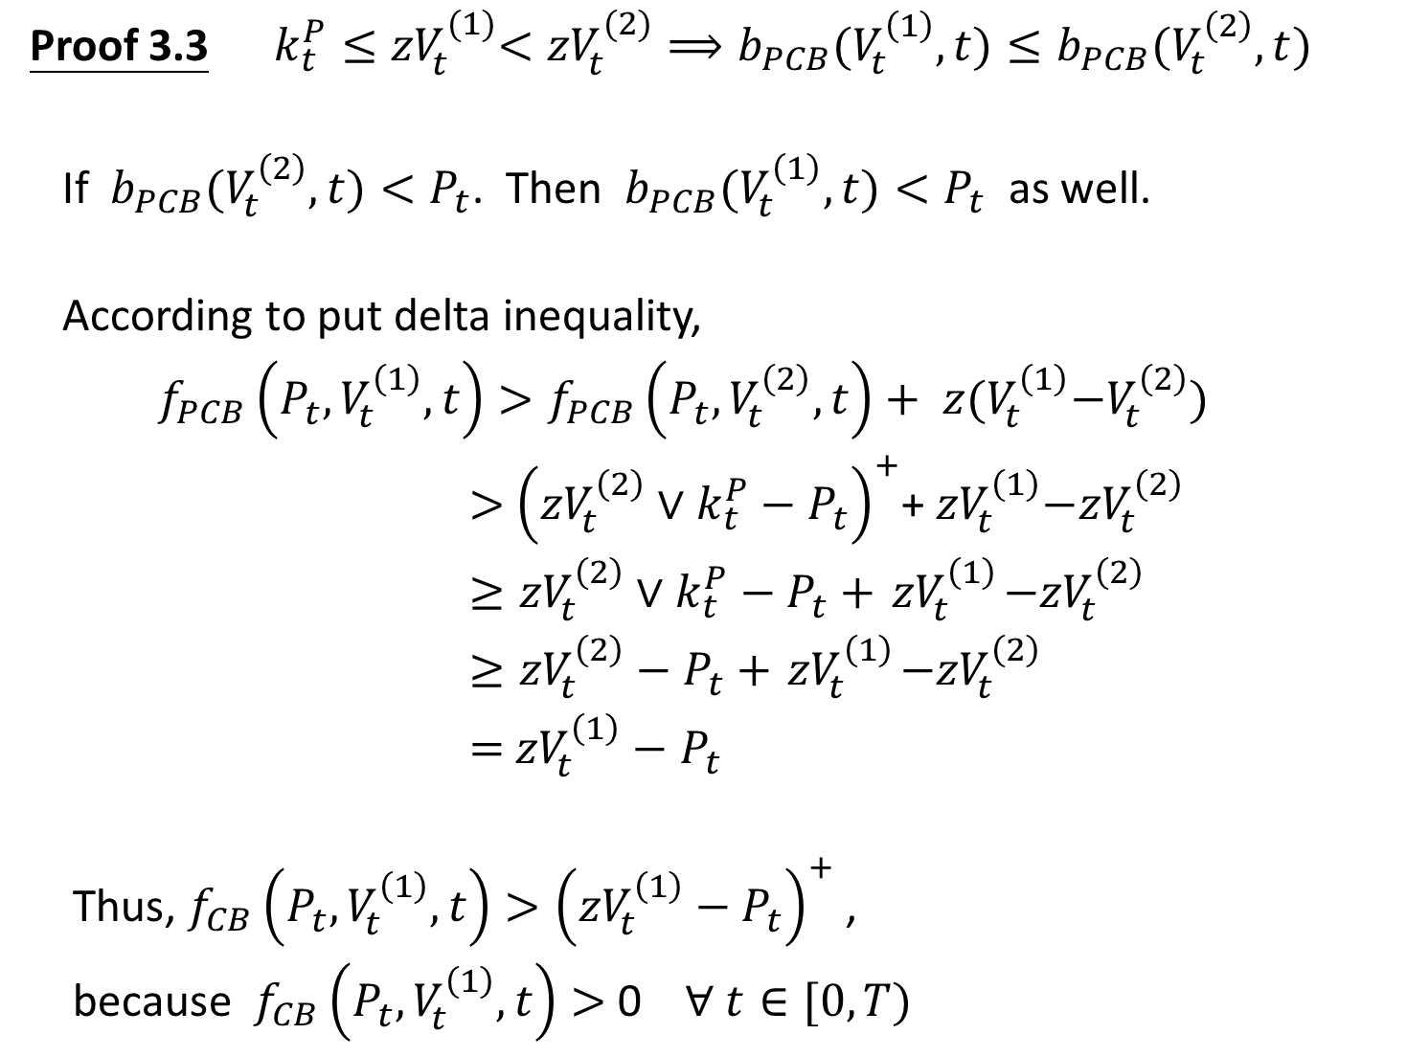
Proof 3.3 $k_{t}^{P}{≤zV}_{t}^{(1)}<{zV}_{t}^{(2)}⟹b_{PCB}(V_{t}^{\left(1\right)},t)≤b_{PCB}(V_{t}^{\left(2\right)},t)$
If $b_{PCB}(V_{t}^{\left(2\right)},t){<P}_{t}$. Then $b_{PCB}(V_{t}^{\left(1\right)},t){<P}_{t}$ as well.
According to put delta inequality,
$f_{PCB}\left(P_{t}^{},V_{t}^{\left(1\right)},t\right)>f_{PCB}\left(P_{t}^{},V_{t}^{\left(2\right)},t\right)+$ ${ z(V}_{t}^{\left(1\right)}−V_{t}^{\left(2\right)})$
$>$ ${\left({zV}_{t}^{\left(2\right)}∨k_{t}^{P}−P_{t}^{}\right)}^{+}$+${ zV}_{t}^{\left(1\right)}−{zV}_{t}^{\left(2\right)}$
$≥{zV}_{t}^{\left(2\right)}∨k_{t}^{P}−P_{t}^{}+{ zV}_{t}^{\left(1\right)}−{zV}_{t}^{\left(2\right)}$
$≥{zV}_{t}^{\left(2\right)}−P_{t}^{}+{ zV}_{t}^{\left(1\right)}−{zV}_{t}^{\left(2\right)}$
$=$ ${zV}_{t}^{\left(1\right)}−$ $P_{t}^{}$
Thus, $f_{CB}\left(P_{t}^{},V_{t}^{\left(1\right)},t\right)>{\left({zV}_{t}^{\left(1\right)}−P_{t}^{}\right)}^{+}$ ,
because $f_{CB}\left(P_{t}^{},V_{t}^{\left(1\right)},t\right)>$ 0 $\text{∀} t∈[0,T)$
in U
in U
in U

Slide 34

Proof 3.4 ${zV}_{t}^{(1)}<{zV}_{t}^{(2)}<k_{t}^{P}⟹ b_{PCB}(V_{t}^{\left(1\right)},t)≥b_{PCB}(V_{t}^{\left(2\right)},t)$
If $b_{PCB}(V_{t}^{\left(1\right)},t){<P}_{t}$. Then $b_{PCB}(V_{t}^{\left(2\right)},t){<P}_{t}$ as well.
$f_{PCB}\left(P_{t}^{},V_{t}^{\left(2\right)},t\right)>f_{PCB}\left(P_{t}^{},V_{t}^{\left(1\right)},t\right)$
$$>{\left({zV}_{t}^{(1)}∨k_{t}^{P}−P_{t}^{}\right)}^{+}$$
$={\left(k_{t}^{P}−P_{t}^{}\right)}^{+}$
$>{\left({zV}_{t}^{(2)}∨k_{t}^{P}−P_{t}^{}\right)}^{+}$
in U
in U

Slide 35
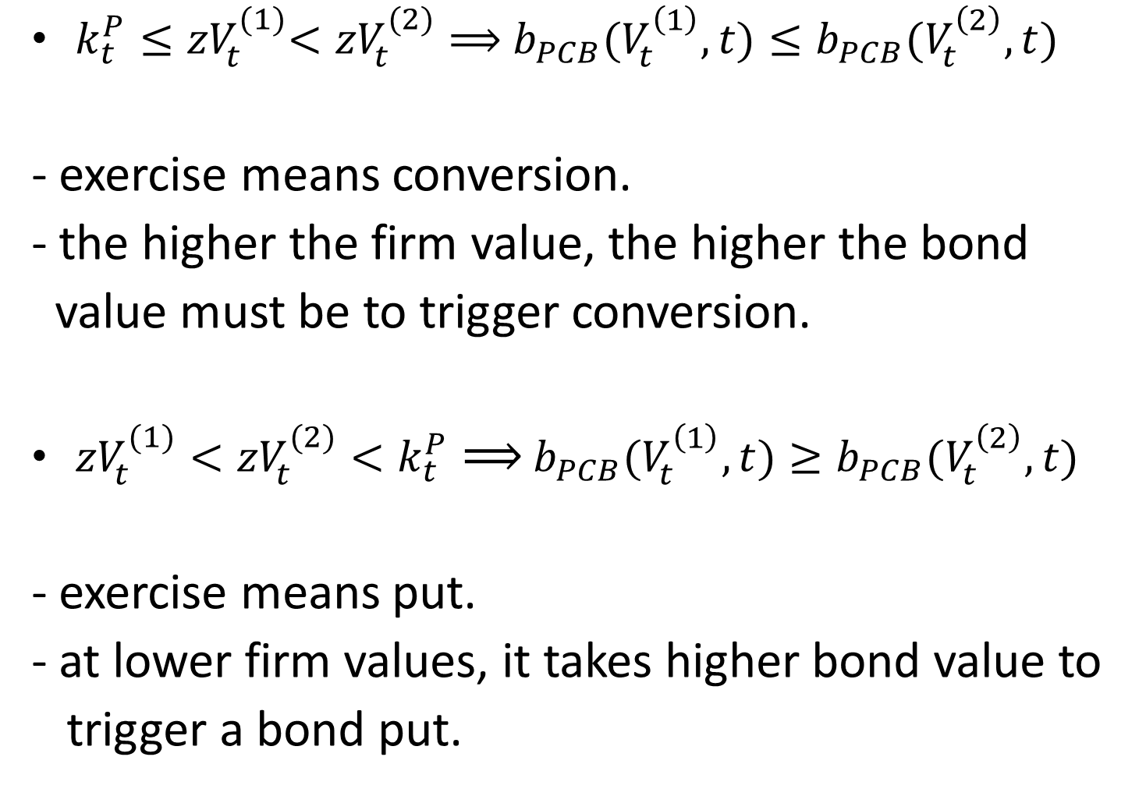
$k_{t}^{P}{≤zV}_{t}^{(1)}<{zV}_{t}^{(2)}⟹$ $b_{PCB}(V_{t}^{\left(1\right)},t)≤b_{PCB}(V_{t}^{\left(2\right)},t)$
- exercise means conversion.
- the higher the firm value, the higher the bond
value must be to trigger conversion.
${zV}_{t}^{(1)}<{zV}_{t}^{(2)}<k_{t}^{P}⟹$ $b_{PCB}(V_{t}^{\left(1\right)},t)≥b_{PCB}(V_{t}^{\left(2\right)},t)$
- exercise means put.
- at lower firm values, it takes higher bond value to
trigger a bond put.

Slide 36
Part 3.C

Slide 37

Theorem 3.C For each $t∈[0,T)$ ,
5. ${zV}_{t}^{}≥k_{t}^{P} ⟹$ $b_{PCB}(V_{t}^{},t)≤b_{CB}(V_{t}^{},t)$ (conversion case)
6. ${zV}_{t}^{}<k_{t}^{P} ⟹$ $b_{PCB}(V_{t}^{},t)≤b_{P}(V_{t}^{},t)$ (put case)

Slide 38

Proof 3.5 ${zV}_{t}^{}≥k_{t}^{P} ⟹$ $b_{PCB}(V_{t}^{},t)≤b_{CB}(V_{t}^{},t)$
If $b_{CB}(V_{t}^{},t){<P}_{t}$, then $b_{PCB}(V_{t}^{},t){<P}_{t}$ .
$f_{PCB}\left(P_{t}^{},V_{t}^{},t\right)≥f_{CB}\left(P_{t}^{},V_{t}^{},t\right)>$ ${\left(zV_{t}^{}−P_{t}^{}\right)}^{+}$
$≥ zV_{t}^{}−P_{t}^{}$
$=$ ${zV}_{t}^{}∨k_{t}^{P}−P_{t}^{}$
$f_{PCB}\left(P_{t}^{},V_{t}^{},t\right)>0 , ∀t∈[0,T)$
Thus $f_{PCB}\left(P_{t}^{},V_{t}^{},t\right)>$ ${\left({zV}_{t}^{}∨k_{t}^{P}−P_{t}^{}\right)}^{+}$
in U
in U

Slide 39

Proof 3.5 ${zV}_{t}^{}<k_{t}^{P} ⟹$ $b_{PCB}(V_{t}^{},t)≤b_{P}(V_{t}^{},t)$
If $b_{P}(V_{t}^{},t){<P}_{t}$, then $b_{PCB}(V_{t}^{},t){<P}_{t}$ .
$f_{PCB}\left(P_{t}^{},V_{t}^{},t\right)≥f_{P}\left(P_{t}^{},V_{t}^{},t\right)>$ ${\left(k_{t}^{P}−P_{t}^{}\right)}^{+}$
$≥k_{t}^{P}−P_{t}^{}$
$=$ ${zV}_{t}^{}∨k_{t}^{P}−P_{t}^{}$
$f_{PCB}\left(P_{t}^{},V_{t}^{},t\right)>0 , ∀t∈[0,T)$
Thus $f_{PCB}\left(P_{t}^{},V_{t}^{},t\right)>$ ${\left({zV}_{t}^{}∨k_{t}^{P}−P_{t}^{}\right)}^{+}$
in U
in U

Slide 40

${zV}_{t}^{}≥k_{t}^{P} ⟹$ $b_{PCB}(V_{t}^{},t)≤b_{CB}(V_{t}^{},t)$
${zV}_{t}^{}<k_{t}^{P} ⟹$ $b_{PCB}(V_{t}^{},t)≤b_{P}(V_{t}^{},t)$
- when both options are present, the value, the
value of preserving one option can make it
optimal for issuer to continue servicing the
debt in states in which it would otherwise
exercise the other option.

